Slide 1
Deep Reinforcement learning
11-364: Intro to deep learning | Rameez Remsudeen

Slide 2
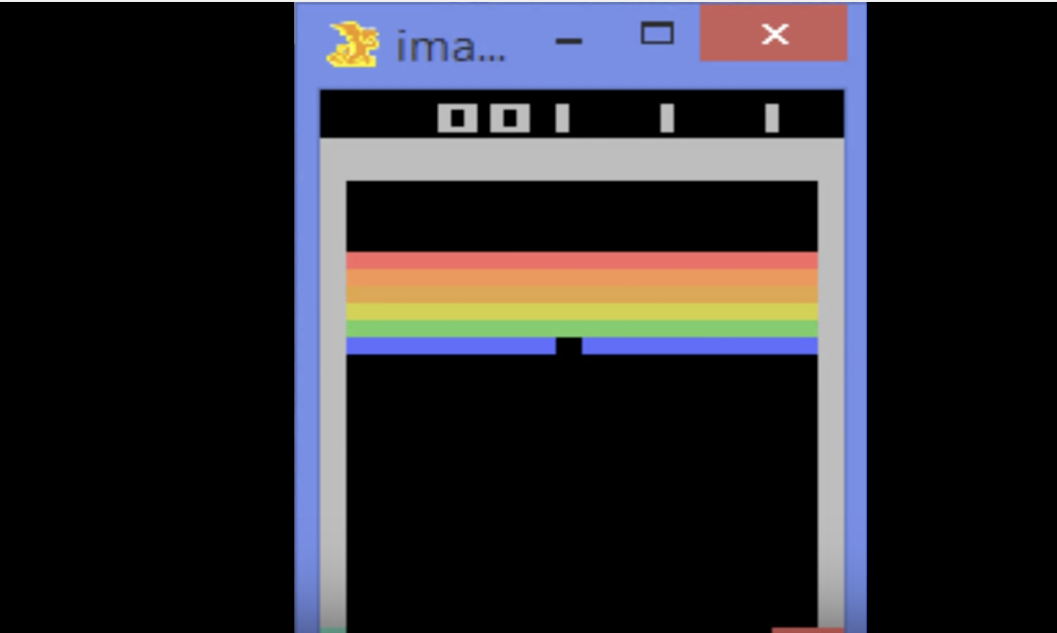
RL Example

Slide 3
Difference b/w RL and un/supervised learning
Actions affect future events
01
There is not supervisor, only reward signals
02
Rewards are far in the future – cannot be myopic
03
Number of examples seen are limited before a critical action has to be made
04
Composing patterns learned is easy, but composing behaviors is harder
05

Slide 4
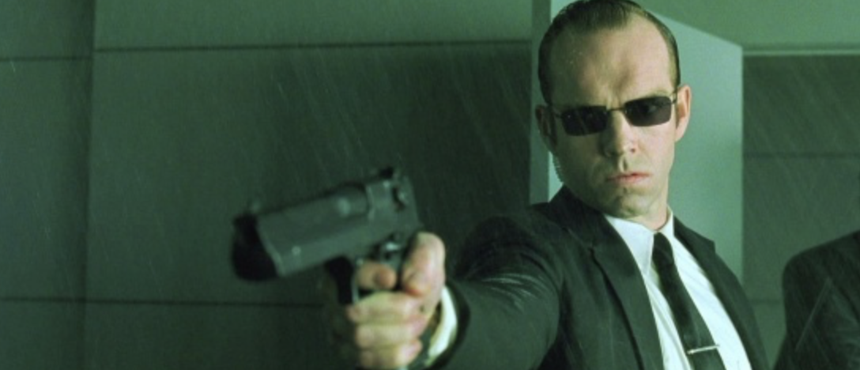
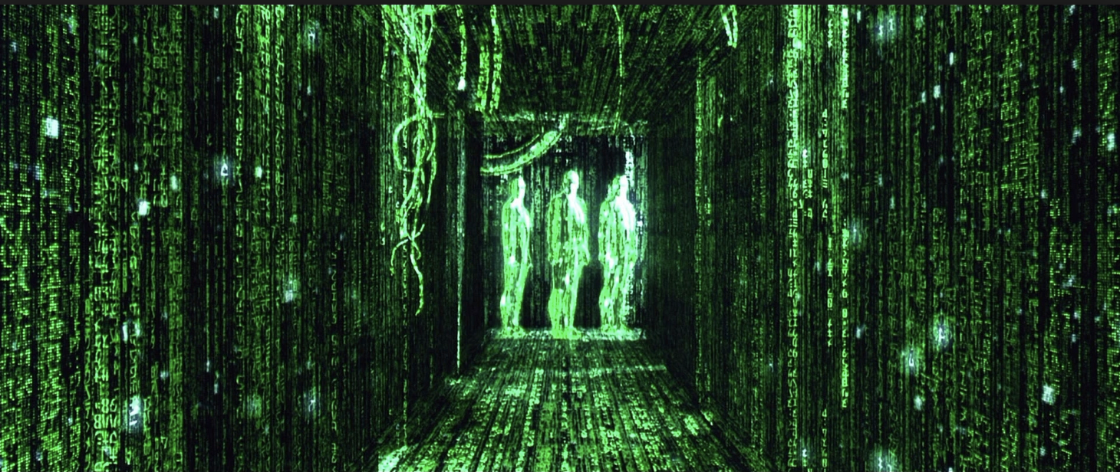
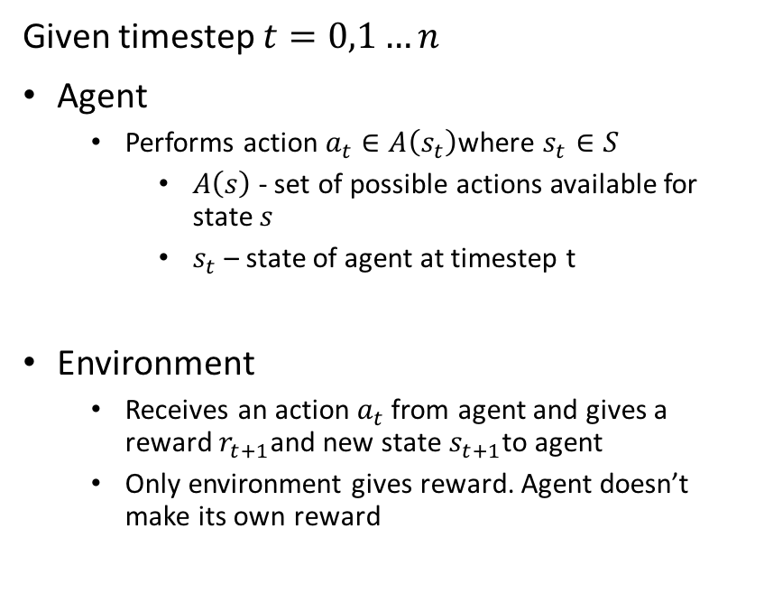
RL.setup()
Given timestep $t=0,1…n$
Agent
Performs action $a_{t}∈A\left(s_{t}\right)$where $s_{t}∈S$
$A\left(s\right)$ - set of possible actions available for state $s$
$s_{t}$ – state of agent at timestep t
Environment
Receives an action $a_{t}$ from agent and gives a reward $r_{t+1}$and new state $s_{t+1}$to agent
Only environment gives reward. Agent doesn’t make its own reward

Slide 5

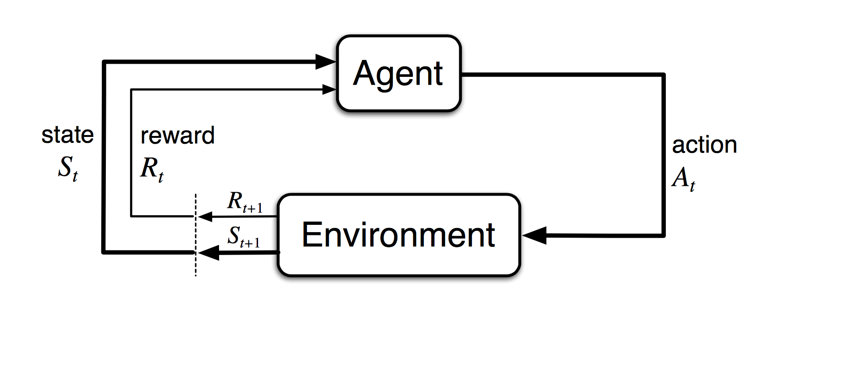

Inside the mind of the agent
Reward is a scalar feedback signal – how well agent is doing at time step $t$
Based on Reward hypothesis
All goals can be described by maximization of expected cumulative reward
Only what should be achieved is specified, not how to
Agent implements mapping from state to probability of selecting possible action through policy $π_{t}$
$π_{t}\left(a \right|s)=$probability that $a_{t}=a is selected given s_{t}=s$
Policy fully determines behavior of the agent
Agent tries to maximize cumulative rewards

Slide 6

Rewards
The return $G_{t}=R_{t+1}+R_{t+2}…. R_{T}$ where G is cumulative future rewards
To ensure convergence we have discounting factor $γ$
Like Epochs, RL uses Episodes – end at time step T or at terminal state
Discounting – sum of discounted rewards over future is maximized
$a_{t}$is chosen s.t. expected discounted return is maximized
$G_{t}=R_{t+1}+γR_{t+2}+γ^{2}R_{t+3}…. ≅ \sum_{k=0}^{∞}{γ^{k}R_{t+K+1}}$
$γ$ can be either 0 or 1
0 = myopic
1 = far sighted

Slide 7
Key insight: Future Independent of past, given the present
Markov Property

Slide 8

Models of RL
Markov Process (chain) given by tuple $<S, P>$
Markov Reward Process given by $<S, P,R, γ>$
Markov Decision Process given by $<S, A, P,R, γ>$
S – set of states
A – set of actions
P – transition probability matrix
P says how likely the next state is given the current state and action
R – reward function, $R\left(a,s\right)=𝔼\left[R_{t+1} \right| S_{t}=s, A_{t}=a]$
$γ$ - discount factor between 0 and 1

Slide 9

Value function
Value function determines how good it is for an agent to be in a state or take an action
State-value function – expected return from starting at state s and following policy $π$
$v_{π}\left(s\right)=𝔼\left[G_{t}\right|S_{t}=s]$
Action-value function (also called q value function) – expected return from starting at state s, taking action a and following policy $π$
$q_{π}\left(s, a\right)=𝔼\left[G_{t}\right|S_{t}=s, A_{t}=a]$

Slide 10

Value function redux: optimized
Optimal value function suggests best possible performance in MDP
Optimal state value function is maximum value function over all policies
$v_{∗}\left(s\right)=\max_{π}{v_{π}(s)}$
Optimal action value function is maximum action value function over all policies
$q_{∗}\left(s,a\right)=\max_{π}{q_{π}(s,a)}$
MDP is solved when optimal value function is known

Slide 11

Optimal Policy
For any MDP, $∃ optimal policy π_{∗}≥π_{a}∀ a∈ℕ$
Optimal policies achieve optimal value functions and optimal action value functions
$v_{π_{∗}}\left(s\right)=v_{∗}\left(s\right) ∀s∈S$
$q_{π_{∗}}\left(s,a\right)=q_{∗}\left(s,a\right) ∀s∈S$

Slide 12
RL Problems
Prediction
Given MDP and a policy, find the state and action value functions
1
Planning
Given MDP find the optimal policy
2

Slide 13
Approaches to RL
Value-based => Estimate optimal value function
Policy based => Search for optimal policy
Model based => Builds model of the environment, often through planning
Model is often learned from experience

Slide 14
Q-learning

Slide 15

Q-value function
Recall discounted future returns - $G_{t}=R_{t+1}+γR_{t+2}+γ^{2}R_{t+3}….$
Thus action value function is
$q_{π}\left(s,a\right)= 𝔼\left[R_{t+1}+γR_{t+2}…\right|s, a]$
$q_{π}\left(s,a\right)= 𝔼_{s^{′},a^{′}}\left[R_{t+1}+γq_{π}\left(s^{′},a^{′}\right) \right| s, a]$, Bellman Equation
Similarly, optimal action value function can be a Bellman equation too
$q_{∗_{π}}\left(s,a\right)= 𝔼_{s^{′} }\left[R_{t+1}+γ\max_{a}^{′}{q_{∗}}\left(s^{′},a^{′}\right) \right| s, a]$

Slide 16
Deep RL
Key Idea:
Represent using neural nets
Value Function
Policy
Model
Use SGD to minimize cost function value

Slide 17

Deep Q Networks
Represent Q values with weights $q_{∗}\left(s,a\right) ≈q(s,a,w)$
Use discounted returns given by Bellman equation as target for cost function
r$+γ\max_{a}^{′}{q\left(s^{′}, a^{′}, w\right)}$
Minimize loss when comparing target to output as current q value
With quadratic cost, $C={\left(r+γ\max_{a}^{′}{q\left(s^{′}, a^{′}, w\right)} −q\left(s,a,w\right)\right)}^{2}$
Stores history of transitions in “experience replay memory”
Minibatch is taken from experience replay memory
$<s,v_{pi}>\sim D where D is experience replace memory$
$∆w=η\left(v_{π}−v^{′}\left(s,w\right)\right)∇_{w}v′(s,w)$

Slide 18
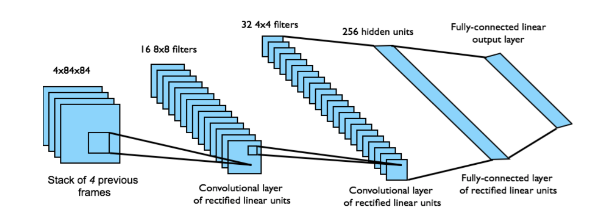
Atari Deep Q Networks
End to end learning of action values from pixel inputs using CNNs
Input state is stack of raw pixels from last 4 frames
Output state is q(s,a) for one of the 18 possible joystick positions
Reward is change in score in time step t

Slide 19
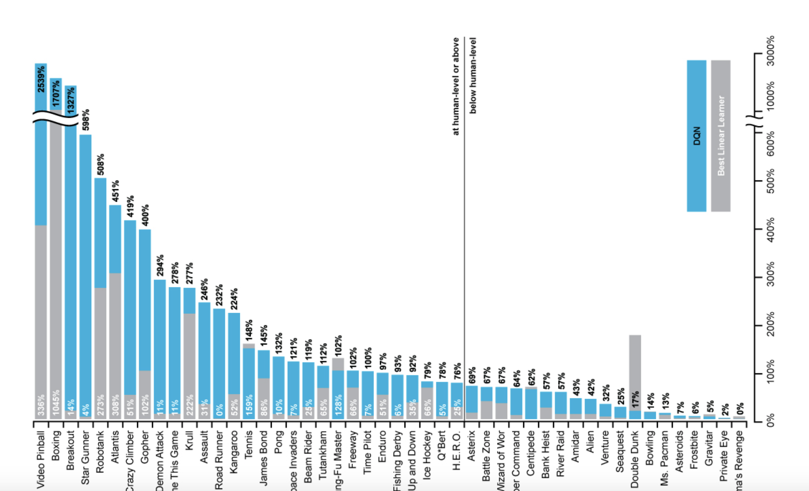
DQN vs non-DQN learners

Slide 20

Double DQNs (Hasset et. Al, deep mind)
Has two action value functions $q_{1}and q_{2}$
Alternate between q-learning on either one, every time step t
$q_{1}or q_{2}$ is picked with 50% probability
$q_{1}\left(s,a\right)←q_{1}\left(s,a\right)+η\left(r+q_{2}\left(s^{′}+argmax_{a}q_{1}\left(s^{′}, a\right)\right)−q_{1}\left(s,a\right)\right)$
In each episode chose action a(s) using policy derived from $q_{1}and q_{2}$
Reduces over estimation of values by decomposing max operation to action selection and action evaluation

Slide 21
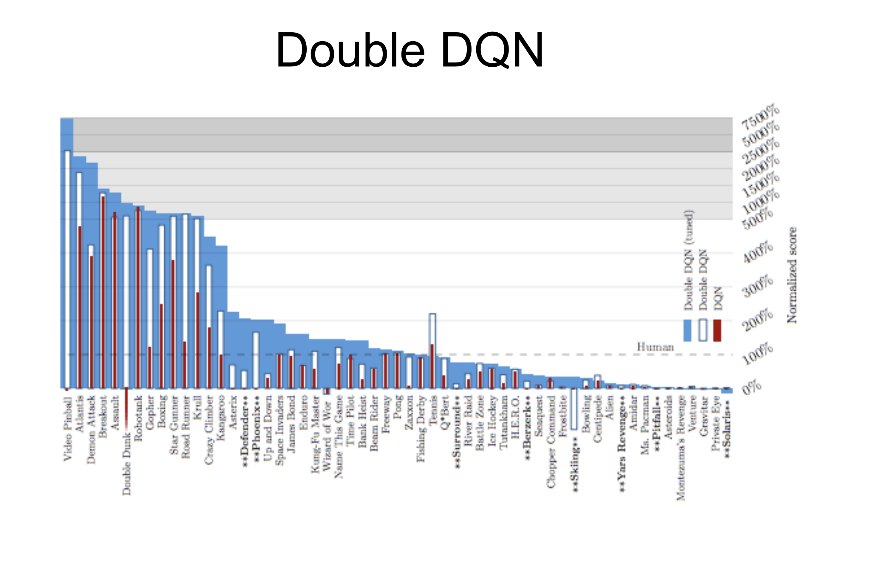
DDQN performance

Slide 22
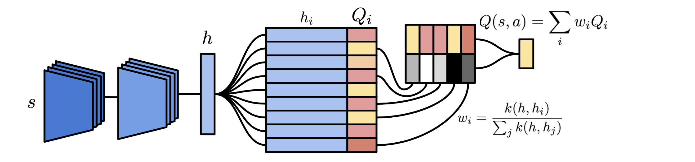

Transfer Learning/Neural Episodic Control
CNN for pixel input (same as DQN)
Backprop works through updating weights and biases of CNN
Key encoded by CNN to represent change in env
Memory module per action
Neural differentiable dictionary (lookup/write)
Lookup maps key h to output value $o= \sum_{i}{w_{i}v_{i}}$
NDD produces an estimate of q(s,a) for a single a
Network converting action from memory module to q(s,a) values
Agent takes the action with the highest q-value estimate at each time step

